Slide 1
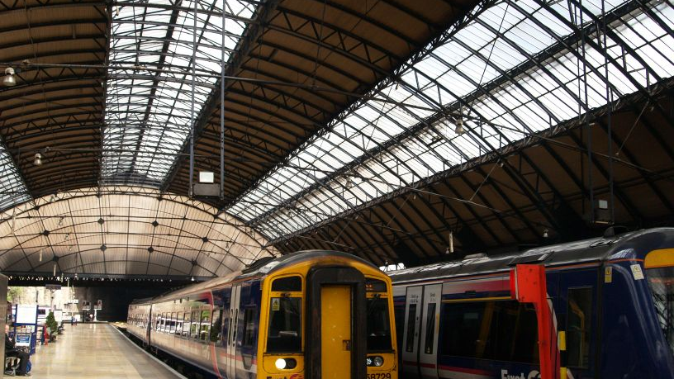
Uk train rides

Slide 2
Columns:
1-transaction id: identify the id of each person who bought a train ticket.
2- date of purchase: the time that the purchase transaction occurs
3-purchase type: is it online or from the train station.
4-payment method: credit, debit, contactless or cash.
5-railcard: available for (adults, seniors, disabled) it gives them 1/3 discount. And none for those who don’t have a card
6-ticket class: where should the passenger sit in (standards or first class)?
7-ticket type: the type of the ticket
Advance: give 50% off but should buy it one day before the trip.ive 50% off but should buy it one day before the trip
Anytime: without offer and at any time of the day
Off-peak: it has 25% off, but it must be used away from peak times(6:8am) (4:6pm)
8-price: we add a condition column (price range)
If it <50=low
If it<=150=medium
Else=high

Slide 3
9-routes: it represents the trips from which station to which station?
10-departure station: the station from which the train departed.
11-date of journey: the day of the trip
12-departure & arrival time: train departure and arrival time.
13-actual arrival time: custom column (duration total hours) is the actual time the train arrived, add custom: (departure time)
Custom column (duration total minute): represent the train delay time, add custom: expected arrival time.
14-category of journey: conditional column
if the trip duration <30minutes=short trip
if the trip<=30minutes= medium
if else=long journey
15-journey status: represent the status of the trips if they arrive on time, are delayed or cancelled.
16-reason for delay: the nulls represent the trips that arrived on time, so we replace the nulls with no delay.
17-refund request: represent if the passenger requests a refund due to a train delay.

Slide 4



cancelled=var a=calculate(count(railway[transaction_id],railway [journey status]=“cancelled")

Slide 5


On time=var a=calculate(count(railway[transaction_id],railway [journey status]="on time")
delayed=var a=calculate(count(railway[transaction_id],railway [journey status]=“delayed")

Slide 6
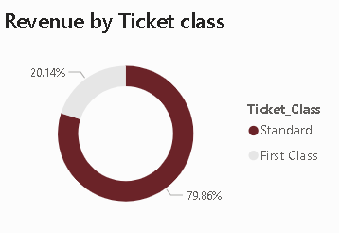

Slide 7
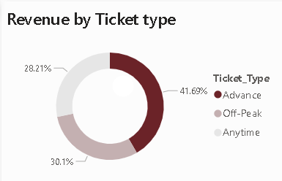

Slide 8
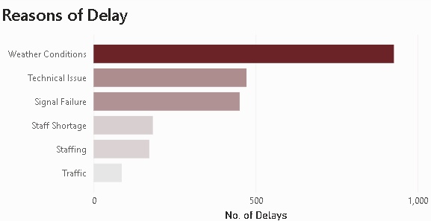

Slide 9
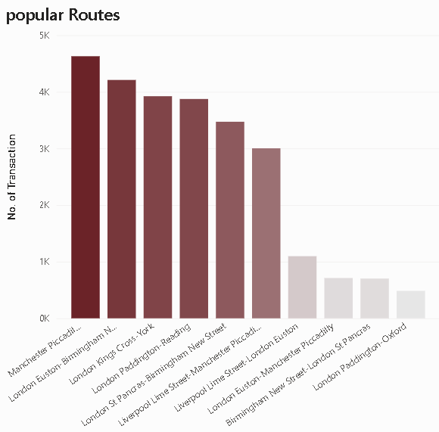

Slide 10
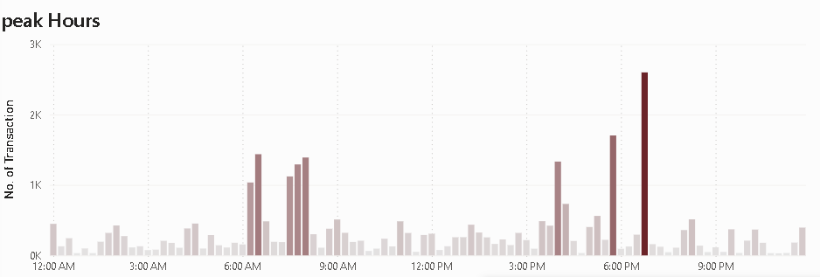

Slide 11
Thank you

